Slide 1

Unit 3

Slide 2
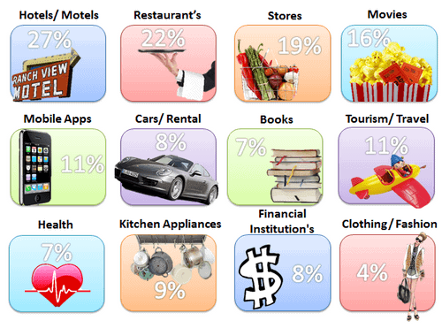
Product
A product is any offering by an organization to satisfy the needs and wants of customers. Product may include goods, services, information, and ideas. An organization needs to take several crucial decisions regarding the product it produces.

Slide 3
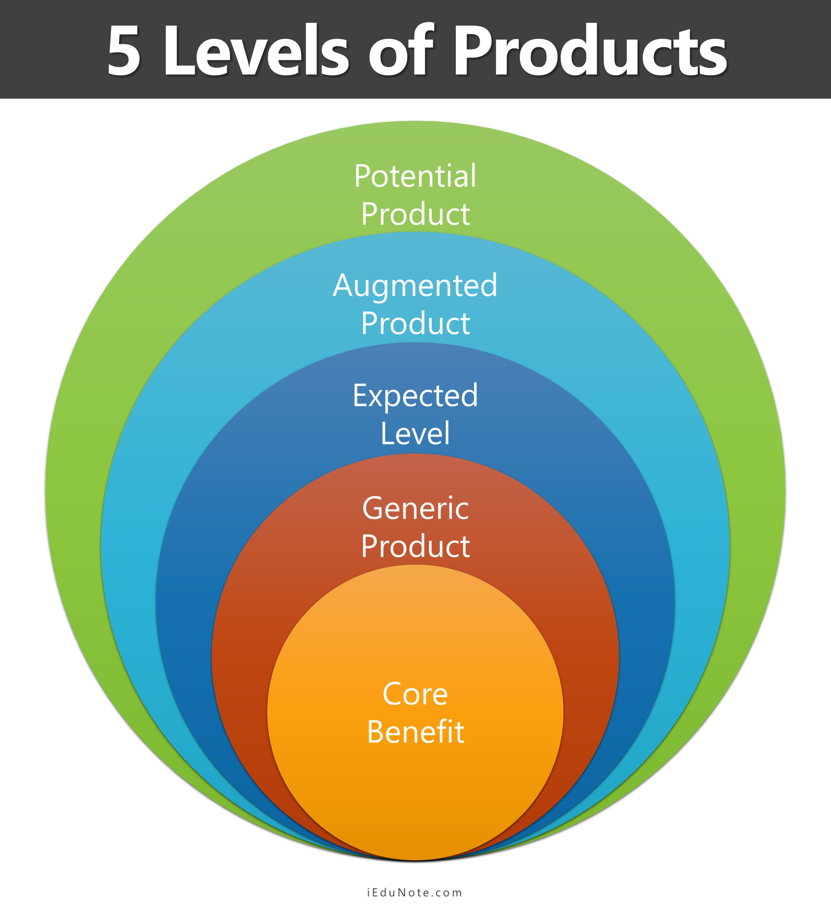

Slide 4
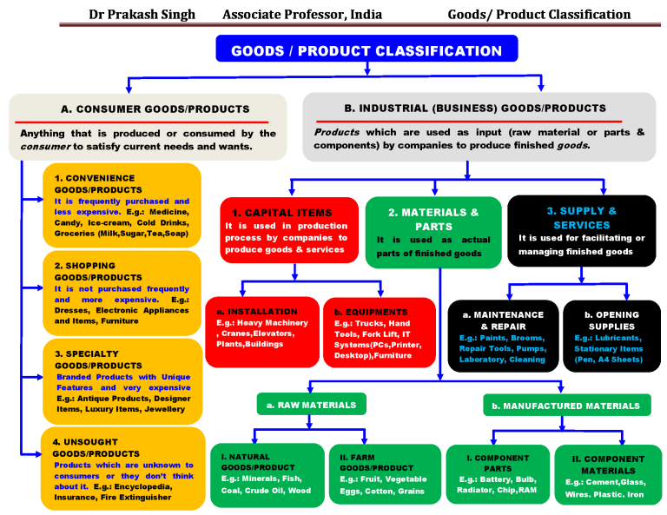

Slide 5

Product Line Analysis
Build
Maintain
Harvest
Divest

Slide 6

PRODUCT MIX
Product mix, also known as product assortment, refers to the total number of product lines a company offers to its customers.

Slide 7
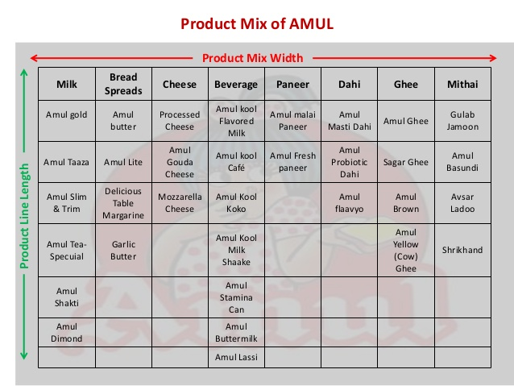
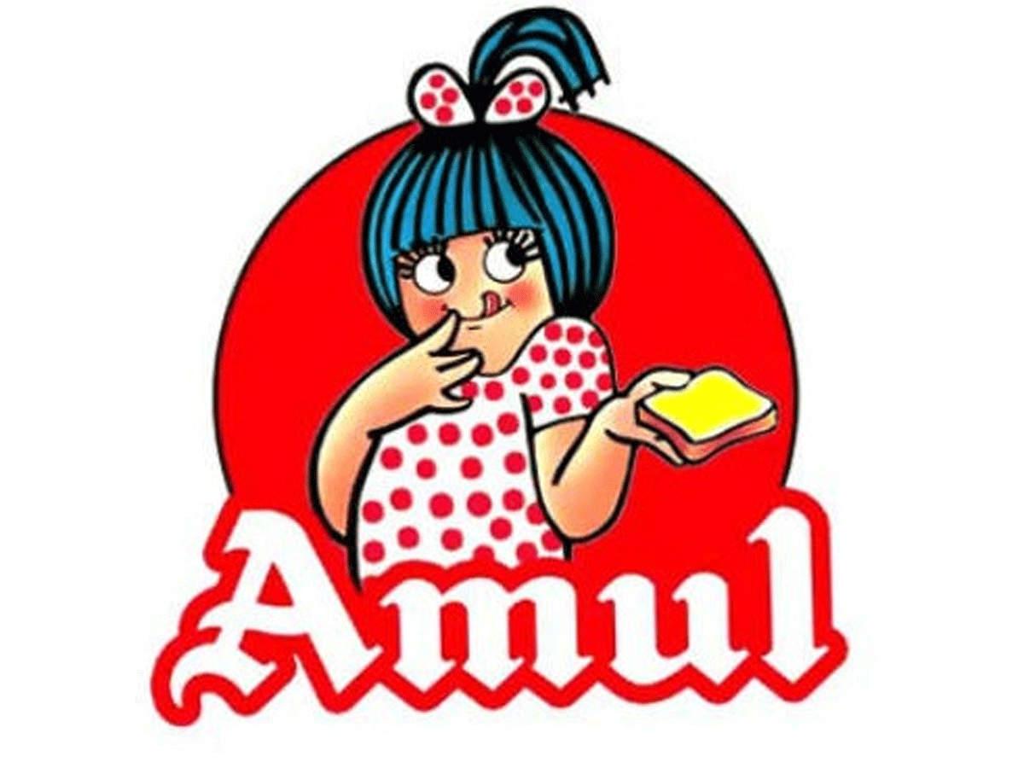

Slide 8
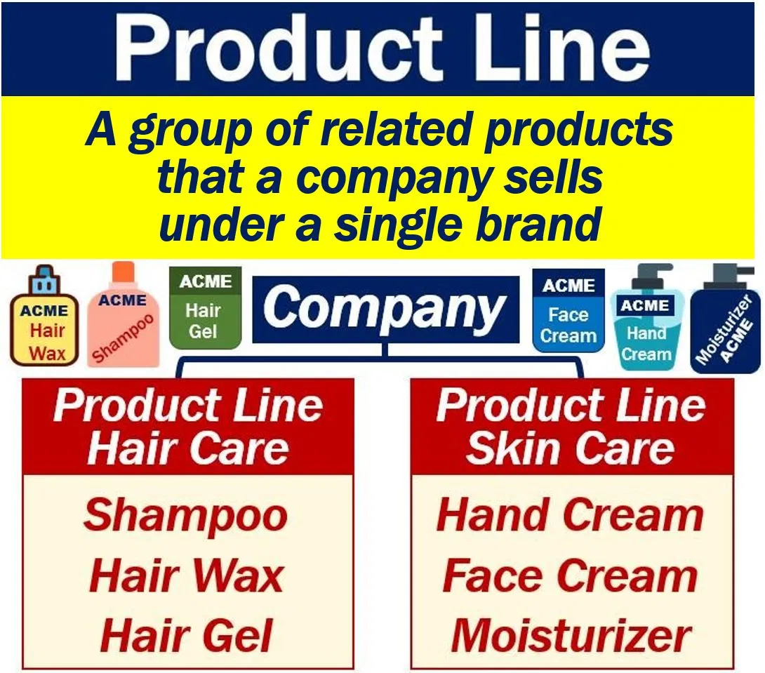

Slide 9
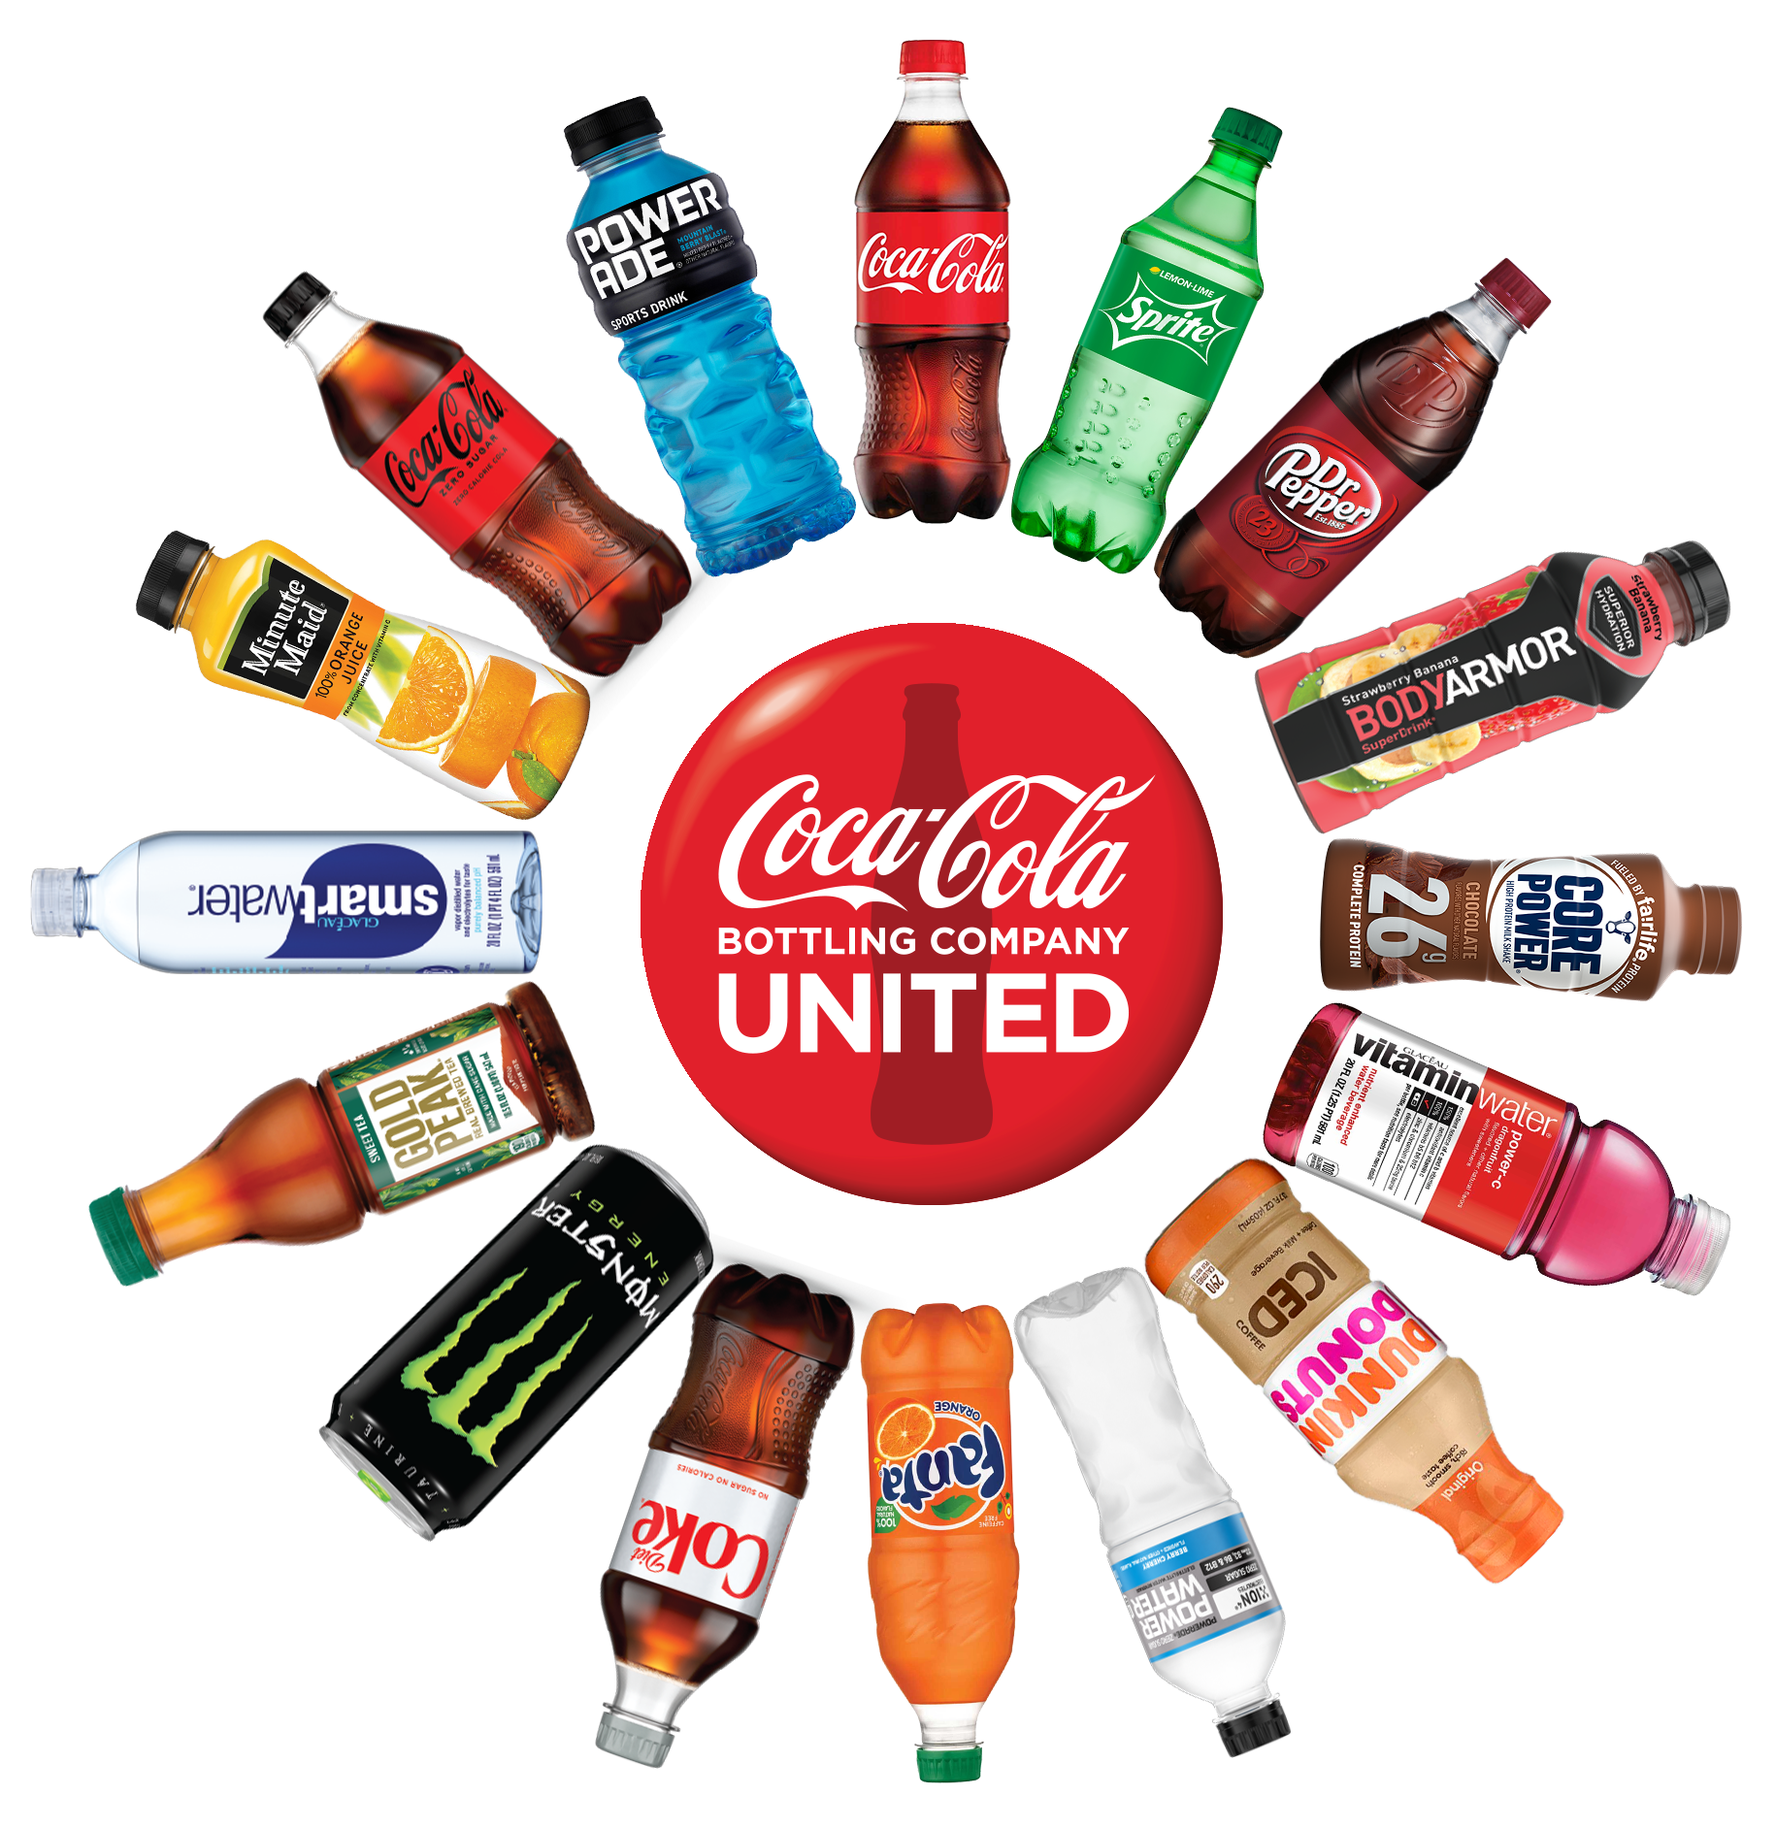
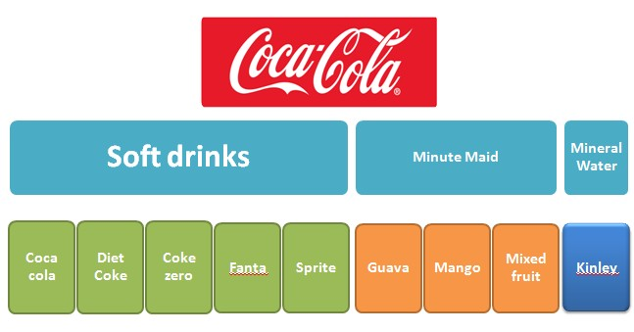
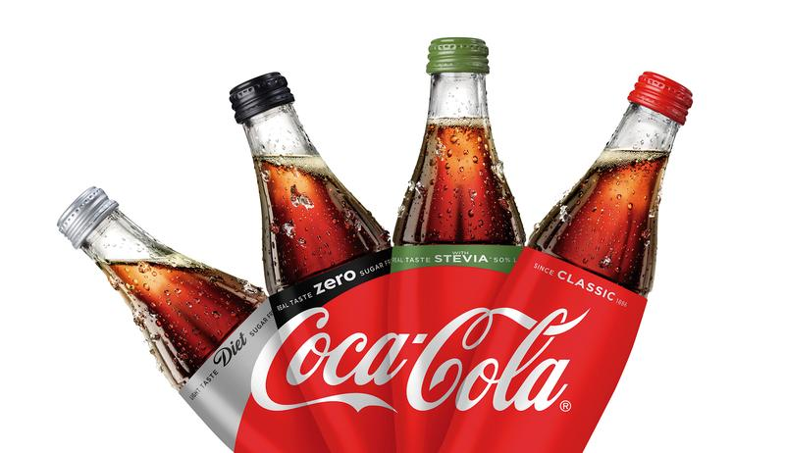

Slide 10


Four Dimensions of Company's Product Mix
Width
Length
Depth
Consistency

Slide 11
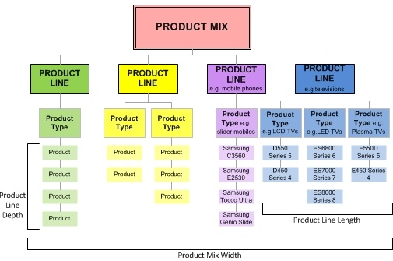

Slide 12
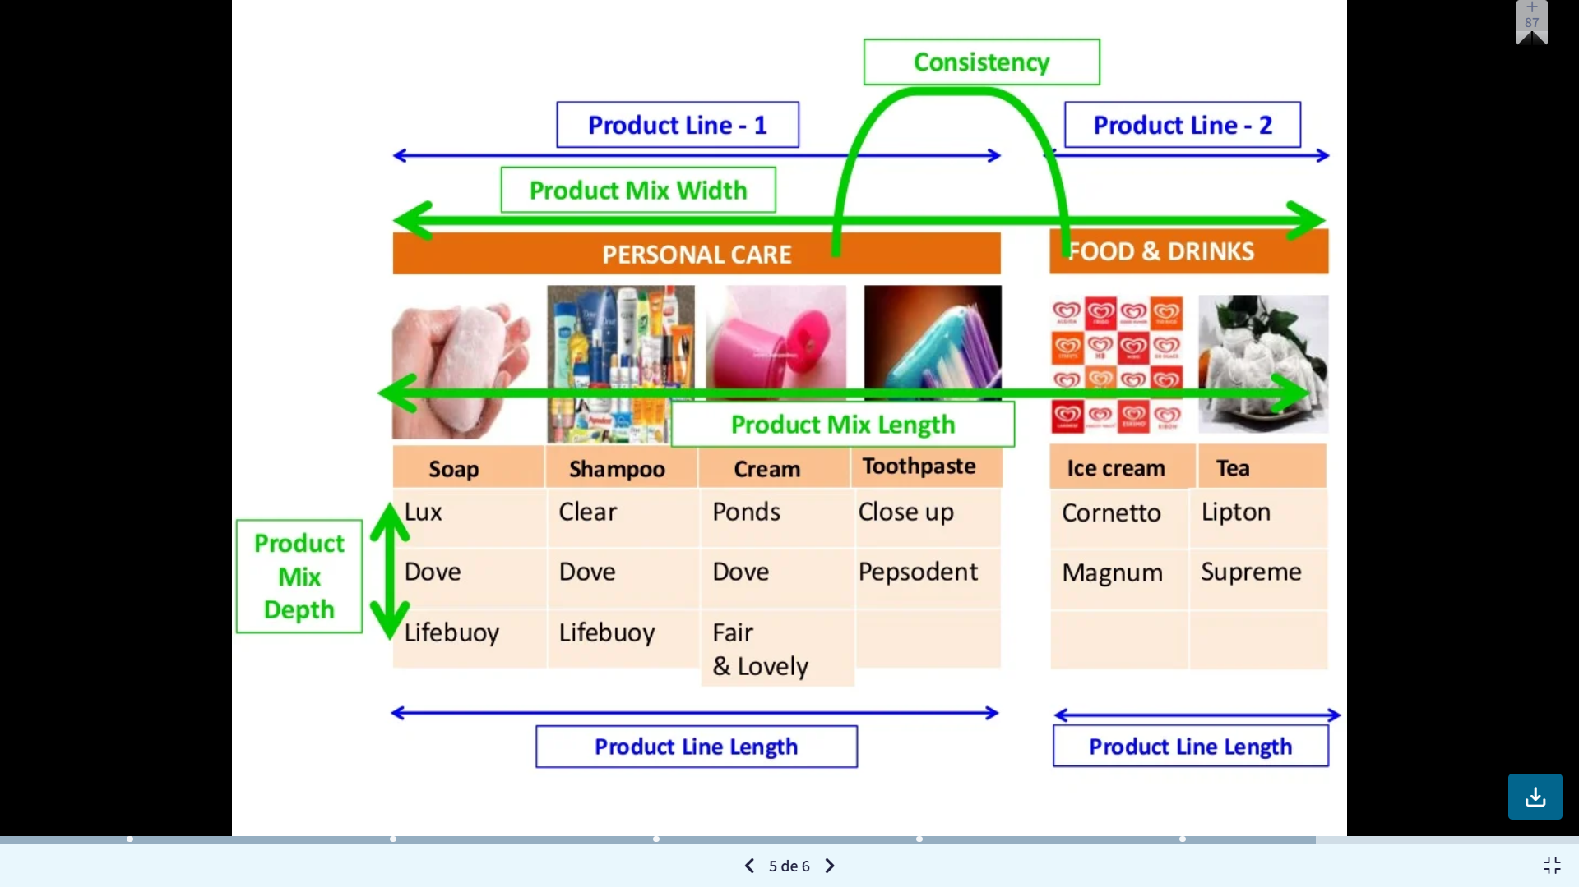

Slide 13
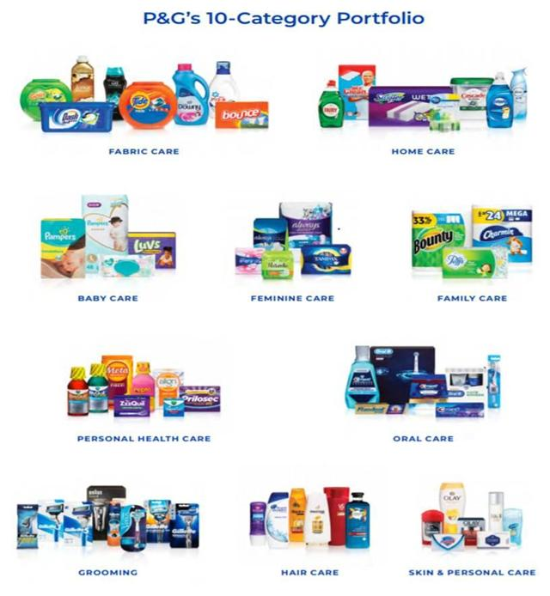


Slide 14
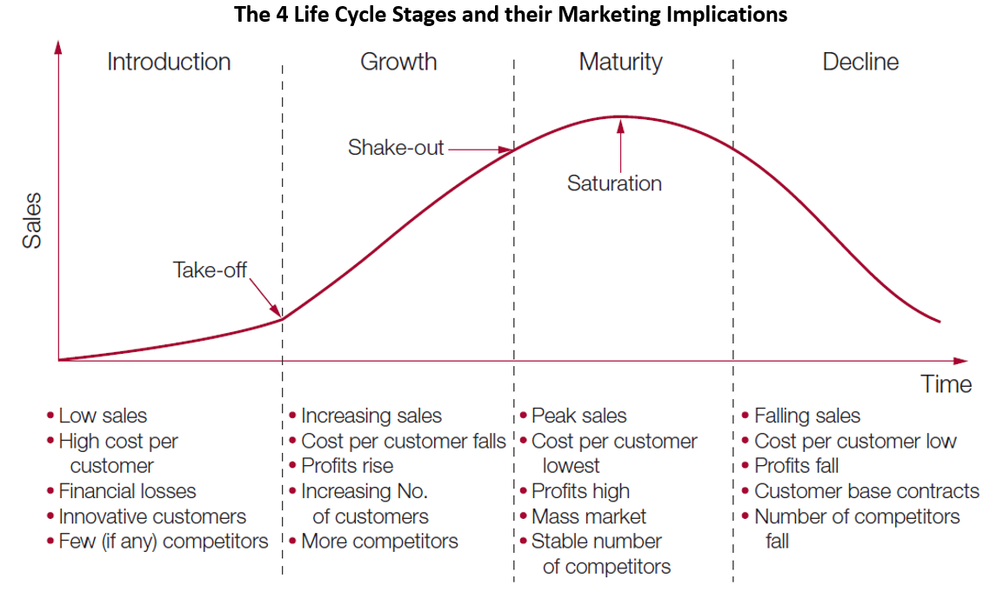
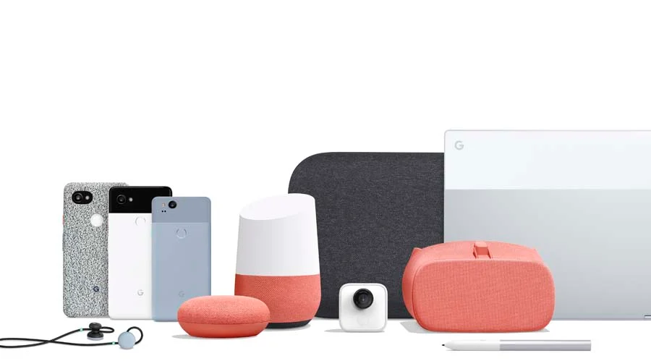


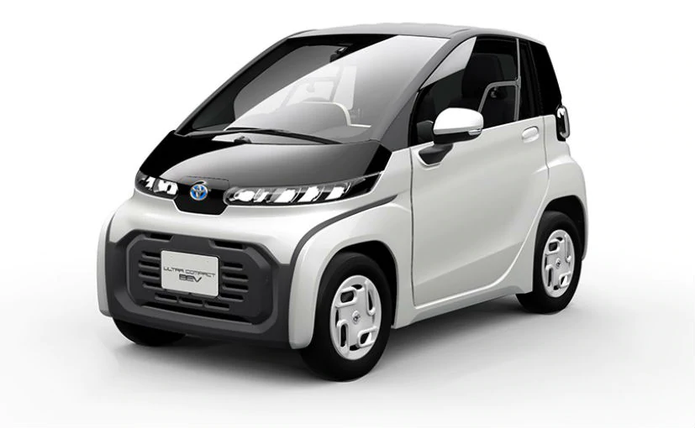

Slide 15


Slide 16

Brand Name
Brand Attribute
Brand Positioning
Brand Identity
Brand Image
Brand Personality

Slide 17


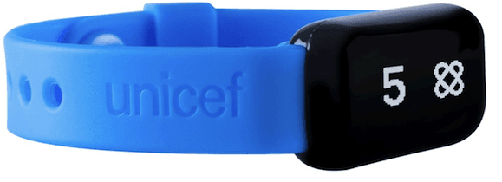
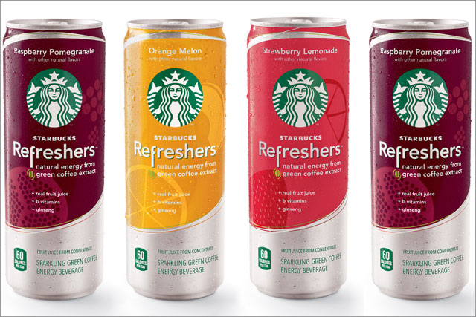

Brand Awareness
Brand Loyalty
Brand Association
Brand Equity
Brand Extension
Co-Branding
Sonic Branding

Slide 18
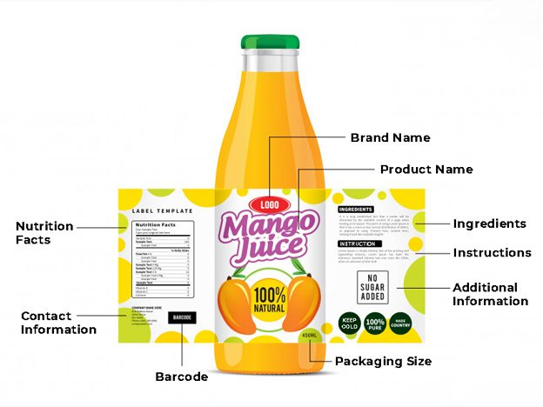
Product Labeling
Label is a small tag placed or attached to a product to identify the product. It is a part of packaging and includes brand name, weight, directions of use, ingredients, and nutritional information about the product.

Slide 19
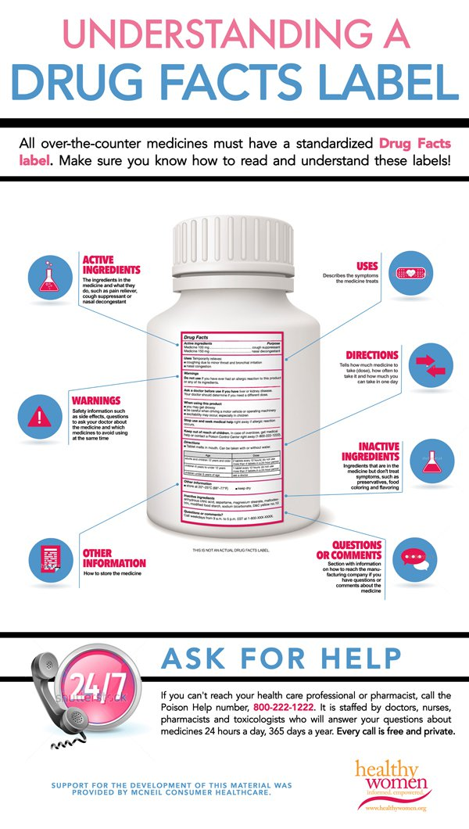
Kinds of Brand Label
Brand Labels
Grade Labels
Descriptive Labels
Informative Labels

Slide 20
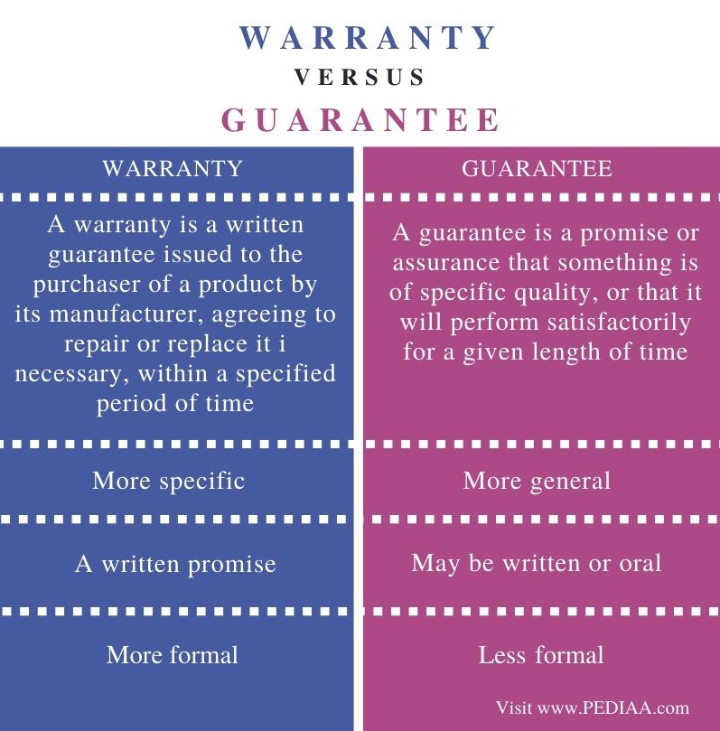



Slide 21
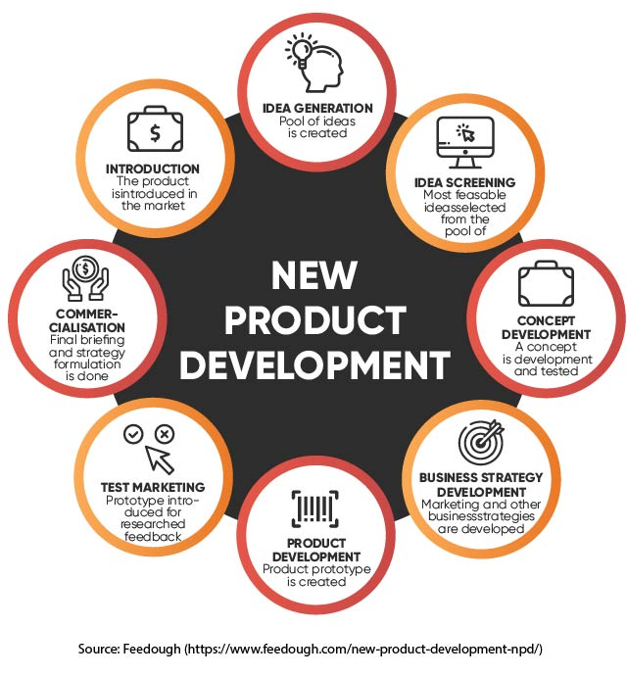


Slide 22
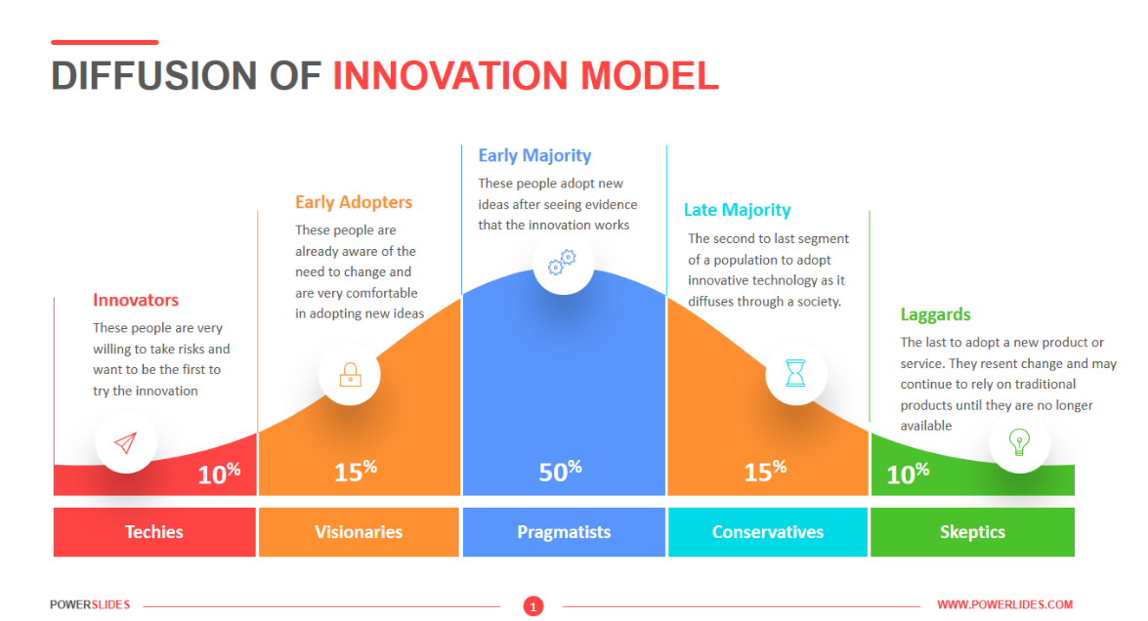

Slide 23
